Slide 1
Selecting/Deselecting a Cement Silo
5.24.24 version 1.0

Slide 2
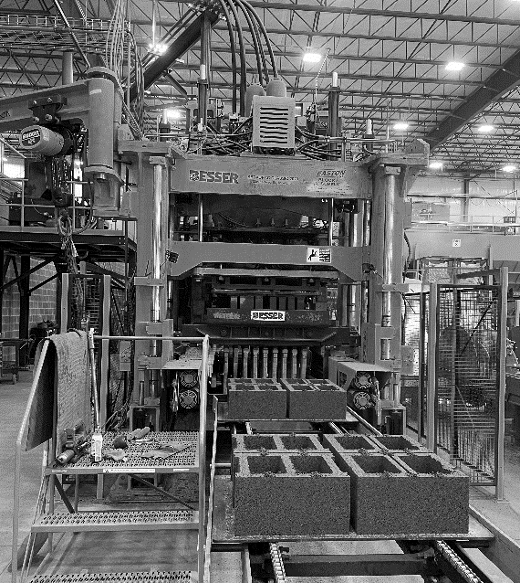
Assumptions and Prerequisite Skills
The computer is on and IntelliBatch 3.0 is open
Supplies Needed
Standard PPE
Air hose with chisel extension (possibly)

Slide 3
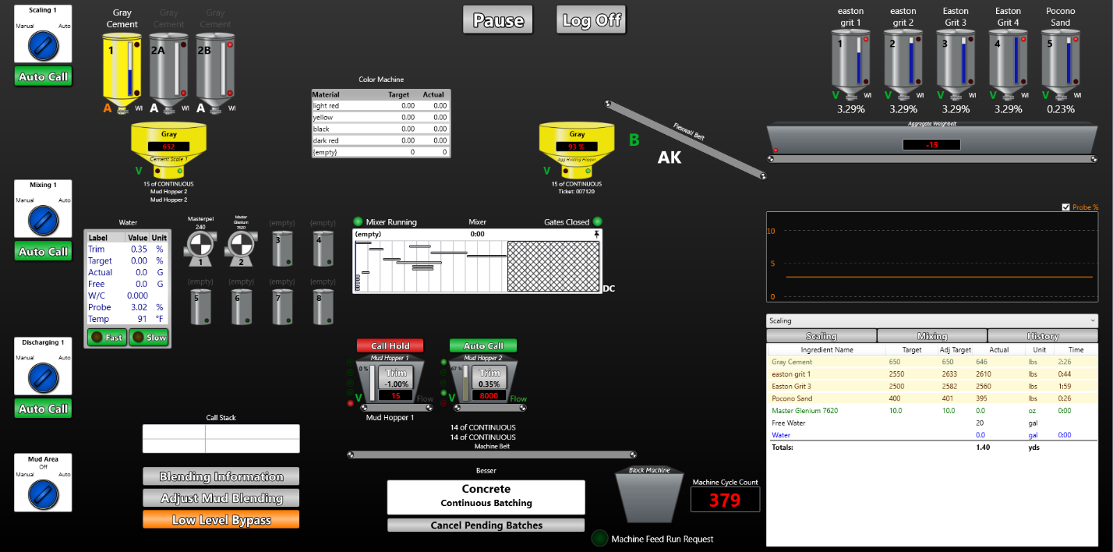
Procedure
1. On the main view page, double click on any of the cement silos on the top left corner (red circle in Figure 1). This will take you to the “Source Assignment” page.

Slide 4
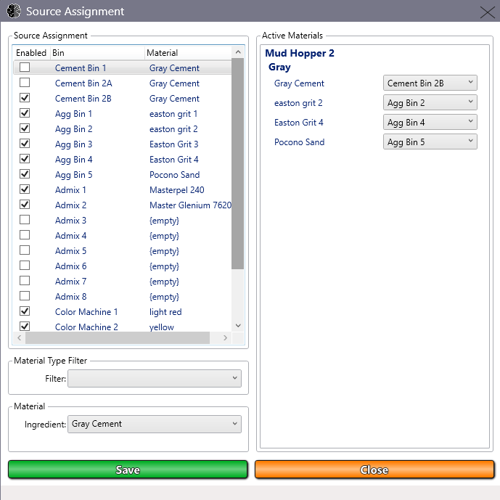
Procedure
Select or deselect a silo by clicking on one of the checkboxes labeled “Cement Bin” (See yellow circle in Figure 2)
On that same page, click the “Save” button
Click the “Close” button when finished
Keep in mind that this new selection applies to the next batch
Figure 2

